Slide 1

A Dual-Mode Solar and Wind Energy Harvesting System Using Rotating Solar Petals with Automatic Mode Switching
Guide Name:
Mrs. Anusha D Y
Assistant Professor
by:
Batch Number: 17
Student names with USN:
Anitha (1JB23EE006)
Chithra B (1JB23EE010)
Rakshita Gulshansing Thakur (1JB23EE037)
Rakshitha MP (1JB23EE038)
1

Slide 2
Contents
Introduction
Literature Survey
Challenges and Motivation
Objectives
Methodology
Flowchart
Block Diagram
Components
Component details & Mechanical Structure
Component details-Electrical & Electronic
3D Model Views- Petal & Wind Turbine Structure
Implementation Progress-Work Done So Far
Expected Outcomes
Plan of Action
References

Slide 3
Introduction
The growing demand for electricity and depletion of fossil fuels highlight the need for efficient renewable energy systems.
Solar and wind energy are clean and abundant but suffer from intermittency when used individually.
This project proposes a flower-shaped hybrid solar–wind energy system that combines both sources in a single compact structure.
The system operates in two automatic modes: Solar Mode, where petals open and track the sun during daytime and Wind Mode, where petals close vertically to function as a Vertical Axis Wind Turbine during low sunlight or night
By integrating solar and wind technologies, the system ensures more reliable power generation with minimal land usage, suitable for urban, rural, and off-grid applications.

Slide 4
Literature survey
Sl. No. | Author Name | Year | Title of the Paper | Publication | Inference
1. | H. Zhang et al. | 2024 | Design and Dynamic Emulation of Hybrid Solar-Wind Energy Converter | IEEE / Scientific Reports (Nature) | This paper demonstrates that combining solar and wind energy improves system reliability and ensures continuous power generation under varying environmental conditions.
2. | R. Kumar and S. Mishra | 2022 | Hybrid Model of Vertical Axis Wind Turbine–Solar Power Generation | IEEE International Conference | The study shows that integrating VAWT with solar panels provides compact and efficient renewable energy generation suitable for urban installations.

Slide 5
3. | Chen, L., Zhang, D., and Wong, K. | 2022 | IoT-Based Real-Time Monitoring Framework for Distributed Renewable Energy Systems | Sensors Journal | The paper presents cloud-based real-time monitoring and data analytics for renewable energy systems, improving remote monitoring and maintenance efficiency.
4. | S. Diaf et al. | 2021 | Solar-Wind Hybrid Energy Generation System | IEEE Conference Proceedings | The study concludes that hybrid solar-wind systems improve power reliability and reduce the intermittency associated with standalone renewable energy sources.

Slide 6
Challenges and Motivation
Challenges
Separate solar and wind infrastructures increase system complexity.
Higher installation cost and land requirements.
Maintenance effort is high in conventional hybrid systems.
Lack of adaptive transformation mechanisms.
Motivation
Reduce system complexity and hardware redundancy.
Enable compact renewable energy solutions.
Demonstrate adaptive mechanical transformation.
Integrate IoT-based monitoring and intelligent control.
Provide cost-effective renewable energy generation.

Slide 7
Objectives
Design and develop an adaptive dual-mode hybrid energy harvesting system using a single integrated structure.
Implement automatic switching between solar and wind modes using intelligent sensor-based control.
Optimize energy generation through efficient power conditioning and energy storage.
Integrate IoT-based real-time monitoring and control through a cloud-connected dashboard.

Slide 8
Methodology
Design adaptive structure using CAD tools.
Solar mode: flat panel configuration for maximum sunlight absorption.
Wind mode: servo-actuated transformation into turbine blade configuration.
Power generated is regulated using MPPT-enabled DC-DC converter.
Energy stored in lithium-ion battery with BMS protection.
ESP32 processes LDR and anemometer data.
Intelligent algorithm performs automatic mode switching.
Firebase cloud and React dashboard provide real-time monitoring.

Slide 9
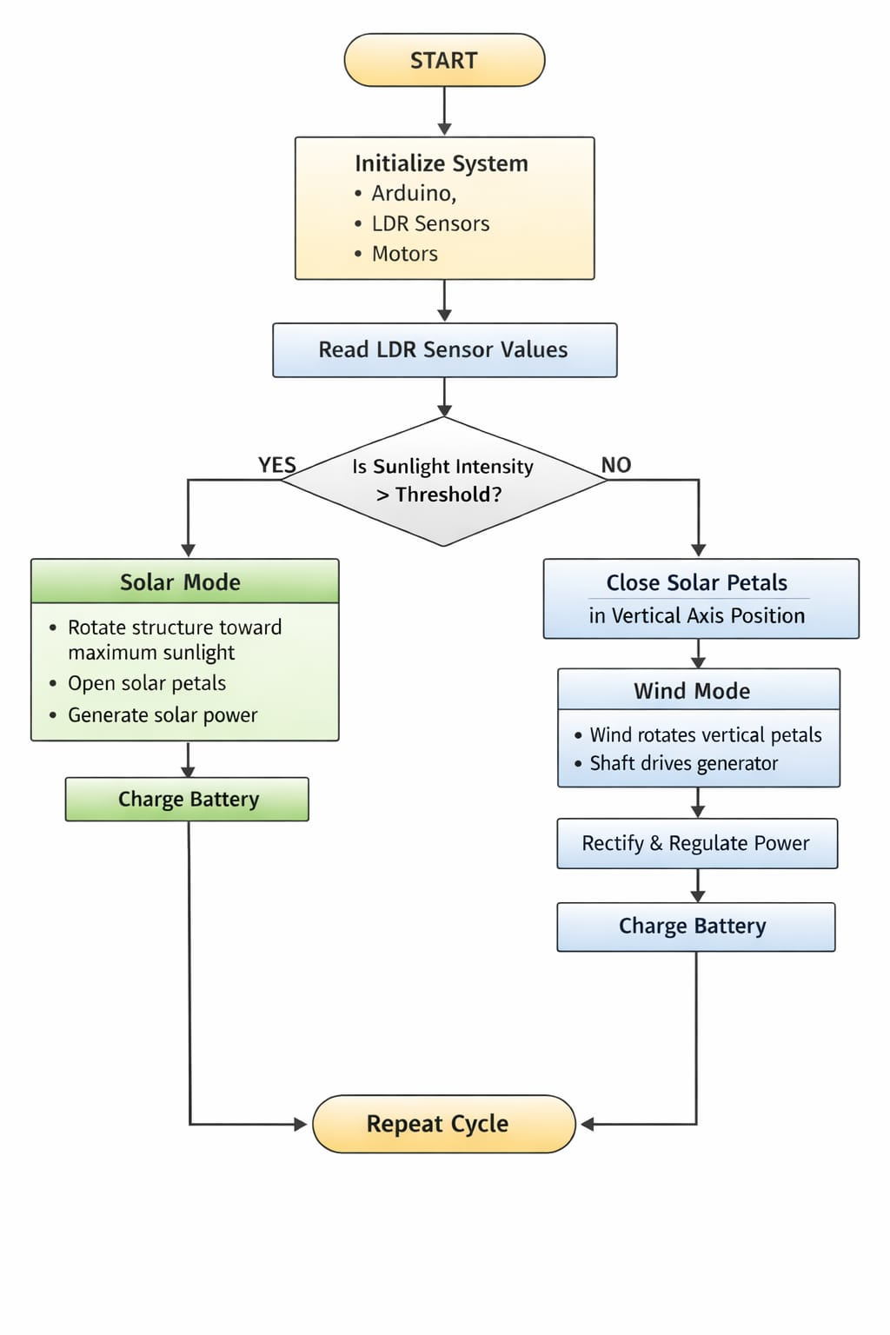
Flowchart

Slide 10
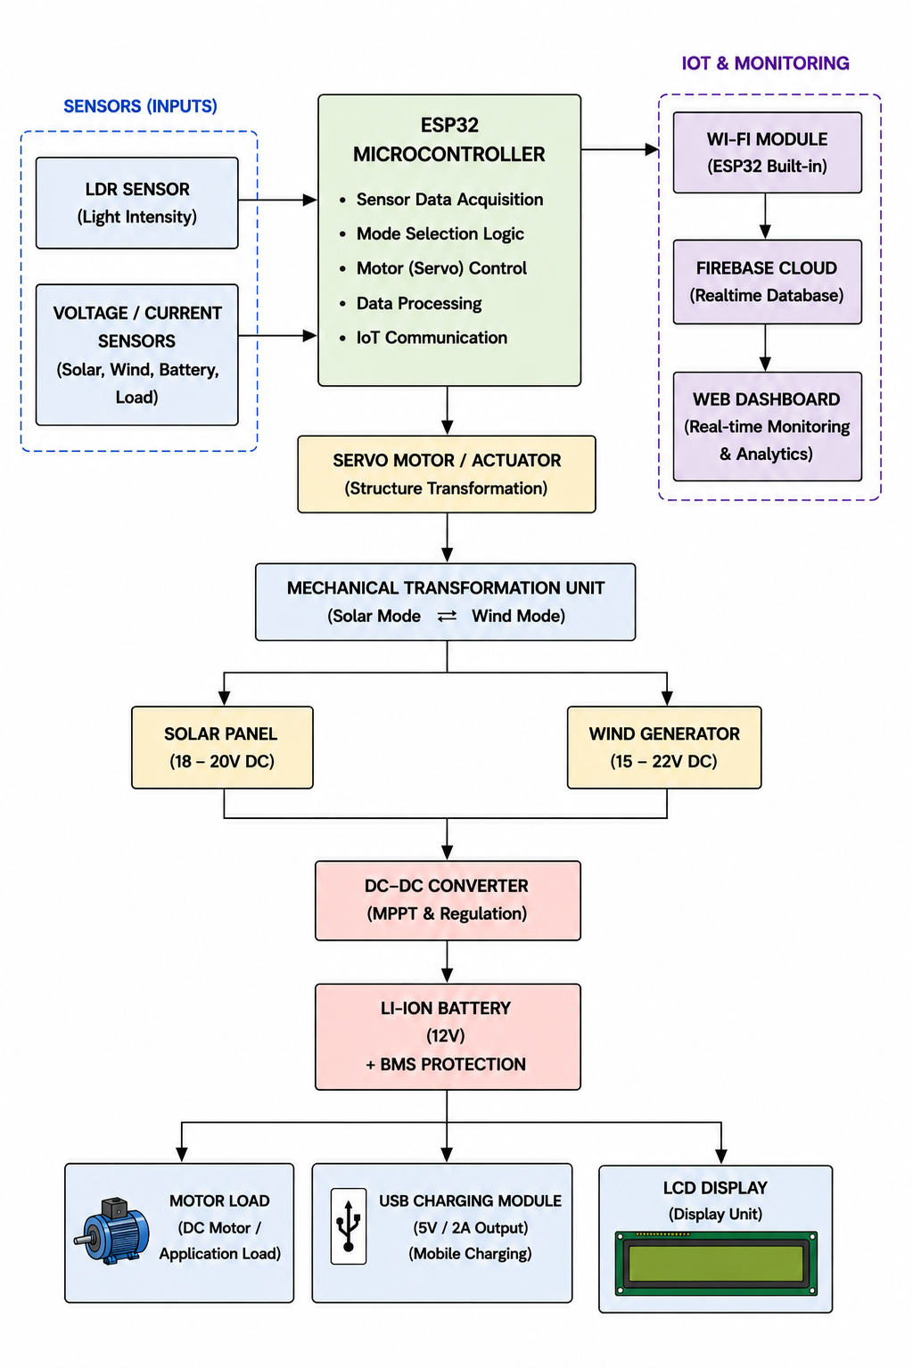
Block Diagram

Slide 11
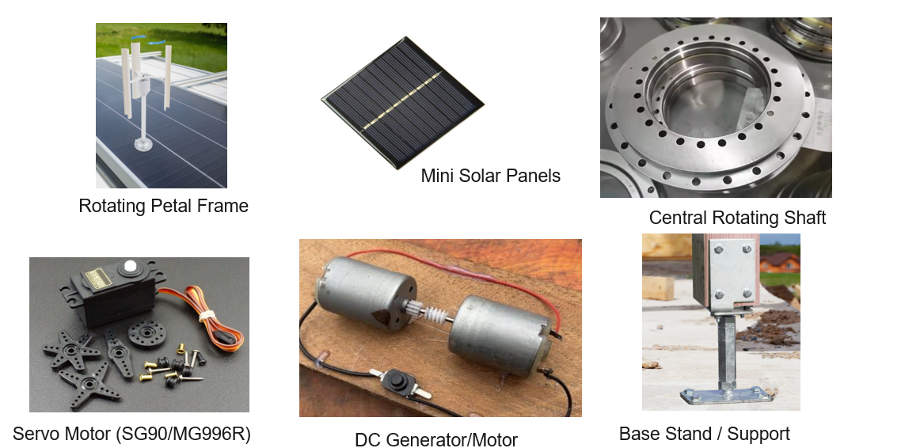
Components

Slide 12
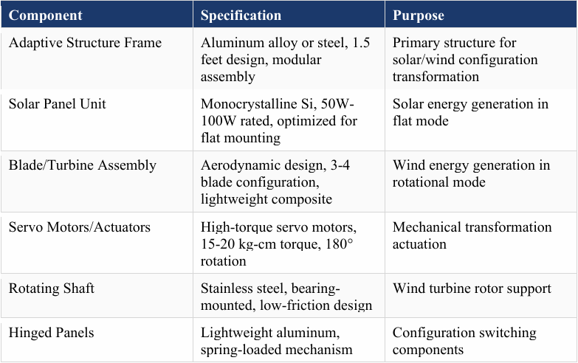
Component Details - Mechanical & Structural
Fig: Mechanical Components

Slide 13
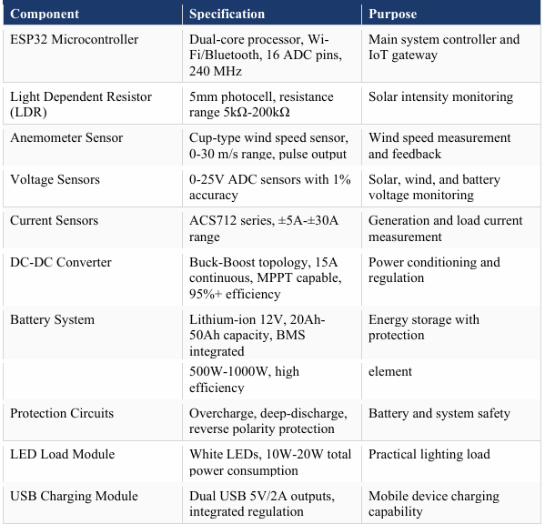
Component Details - Mechanical & Structural
Fig: Electrical Components

Slide 14
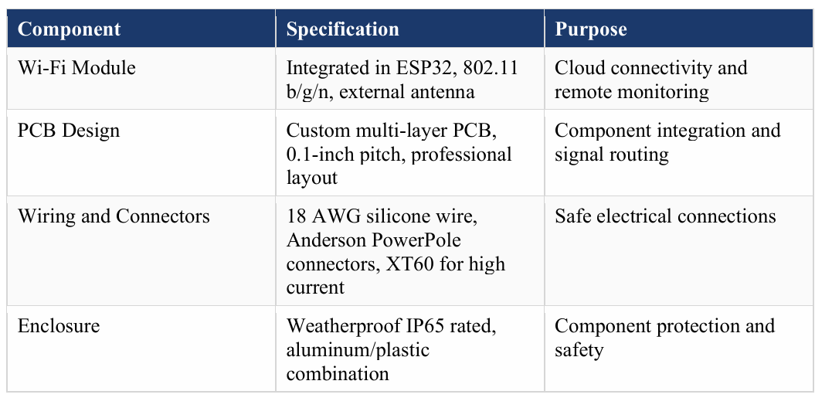
Component Details - Mechanical & Structural
Fig: Communication and Power Distribution

Slide 15
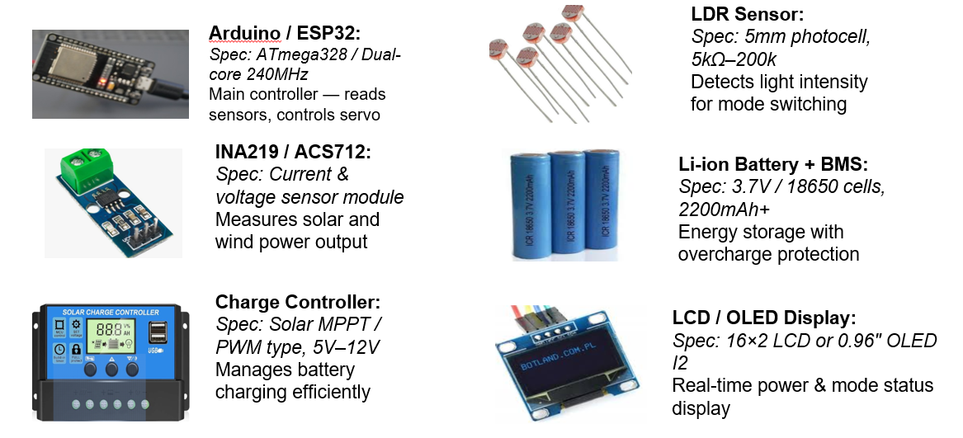
Component Details - Electrical & Electronic

Slide 16
Software requirements and specifications
1. Microcontroller Firmware
ESP32 firmware collects sensor data and controls system operation using programmed decision logic.
PWM signals are used to drive servo motors and actuators for automatic mode switching and tracking.
2. Cloud Platform
Firebase Realtime Database enables instant synchronization of data between the device and cloud.
Cloud storage provides secure access, monitoring, and management of system data from anywhere.
3. Web Dashboard
Displays real-time system parameters such as voltage, current, battery status, and operating mode.
Provides graphical analysis, alerts, and configuration options through a responsive user interface.

Slide 17
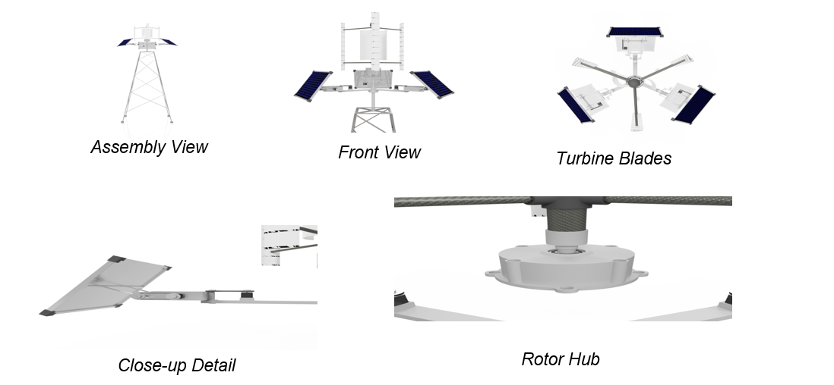
3D Model Views - Petal & Wind Turbine Structure

Slide 18
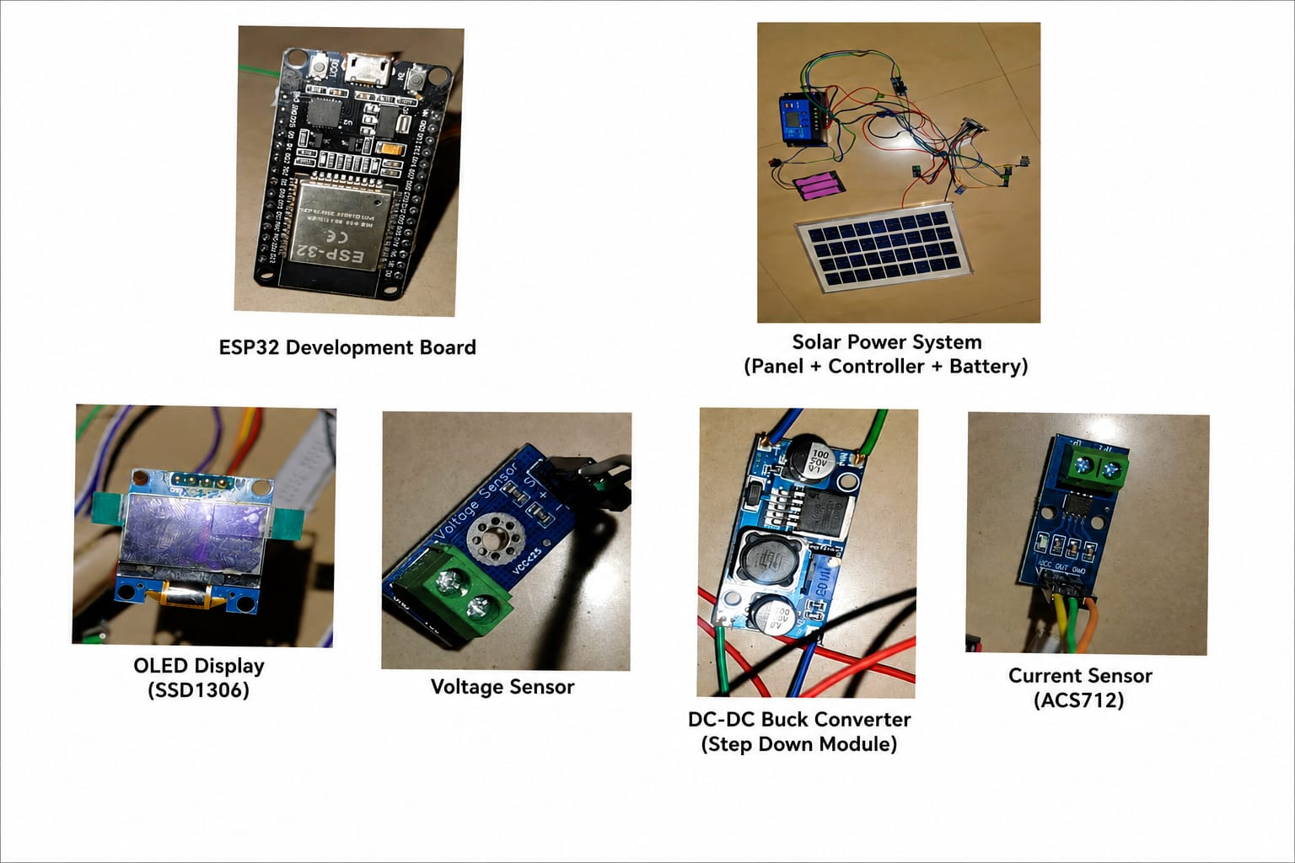
Working model components

Slide 19
Implementation Progress - Work Done So Far
Completed literature survey and analysis of hybrid renewable energy systems, adaptive structures, and IoT monitoring technologies.
Finalized the system architecture and operational methodology for the dual-mode solar–wind energy harvester.
Designed the adaptive rotating petal mechanism using CAD tools.
Successfully fabricated the initial prototype frame and rotating petal assembly.
Completed mechanical testing and verified stable rotation and transformation between solar and wind modes.
Integrated and tested the solar panel, wind generator, battery charging circuit, and DC-DC converter.
Implemented ESP32-based control system with LDR and wind sensing mechanisms.
Established Wi-Fi communication between ESP32 and Firebase Cloud platform.
Achieved basic real-time monitoring of voltage, current, battery status, and operating mode through the web dashboard.
Full system integration, optimization, and final performance evaluation are currently in progress.

Slide 20
Expected Outcomes
Efficient renewable energy generation through automatic switching between solar and wind modes.
Adaptive rotating petals respond to sunlight intensity and wind speed for optimized energy harvesting.
Mode-switching accuracy greater than 95% using ESP32-based intelligent control.
Solar power output of approximately 80–100 W under adequate sunlight conditions.
Wind power output of approximately 45–85 W during sufficient wind conditions.
MPPT-based DC-DC converter achieving energy conversion efficiency above 90%.
Lithium-ion battery providing reliable energy storage and backup power.
Real-time monitoring of voltage, current, battery status, and operating mode through Firebase cloud and web dashboard.
Reduced installation space and hardware redundancy compared to conventional hybrid systems.
Suitable for smart energy applications, rural electrification, and off-grid power generation.

Slide 21
Conclusion
Successfully developed an adaptive dual-mode renewable energy harvesting system combining solar and wind energy generation.
Implemented automatic mode switching based on environmental conditions using intelligent sensor-based control.
Demonstrated the feasibility of mechanical transformation between solar and wind operating modes.
Integrated ESP32-based IoT monitoring for real-time data visualization and remote system management.
Reduced system complexity, installation space, and hardware redundancy compared to conventional hybrid systems.
Improved operational flexibility and renewable energy utilization through intelligent control and adaptive design.
Established a foundation for next-generation smart, sustainable, and cost-effective renewable energy solutions.
Suitable for off-grid applications, rural electrification, and distributed renewable energy systems.

Slide 22
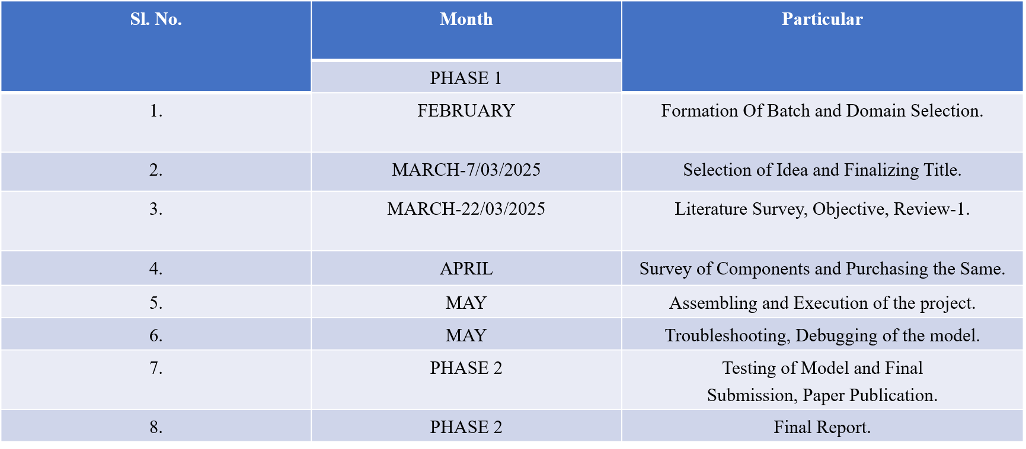
Plan of action

Slide 23
References
H. Zhang et al., “Design and Dynamic Emulation of Hybrid Solar-Wind Energy Converter,” IEEE / Scientific Reports (Nature), 2024.
R. Kumar and S. Mishra, “Hybrid Model of Vertical Axis Wind Turbine–Solar Power Generation,” IEEE International Conference, 2022.
Chen, L., Zhang, D., Wong, K., and Liu, Y., “IoT-based Real-Time Monitoring Framework for Distributed Renewable Energy Systems,” Sensors, 2022.
S. Diaf et al., “Solar-Wind Hybrid Energy Generation System,” IEEE Conference Proceedings, 2021.
Espressif Systems, “ESP32 Series Datasheet,” Version 5.0, 2023.
Firebase Documentation, “Realtime Database Technical Guide,” Google Cloud Platform, 2023.

Slide 24


Thank You

